Slide 1

Department of
CE - AI
01CE1101 - Computer Programming
Unit - 5
Functions

Slide 2
Functions
A function is a block of statements that performs a specific task.
It contains the set of programming statements enclosed by {}.
A function is a block of code which only runs when it is called.
You can pass data, known as parameters, into a function.
A function can be called multiple times to provide reusability and modularity to the C program.

Slide 3
Need for functions
a) To improve the readability of code.
b) Improves the reusability of the code, same function can be used in any program rather than writing the same code from scratch.
c) Debugging of the code would be easier if you use functions, as errors are easy to be traced.
d) Reduces the size of the code, duplicate set of statements are replaced by function calls.

Slide 4
Functions
Functions are broadly classified into two types :
Library Functions: are the functions which are declared in the C header files such as scanf(), printf(), sqrt(), pow(), strcat(), strlen() etc.
User-defined functions: are the functions which are created by the programmer. It reduces the complexity of a big program and optimizes the code.
Example: A Function int add(int a, int b) can be written to return the sum of two numbers.

Slide 5
Create a Function
To create (often referred to as declare) your own function, specify the name of the function, followed by parentheses () and curly brackets {}
Syntax:
return_type function_name( parameter list )
{
// body of the function
}

Slide 6
Create a Function
Where:-
return_type:
The return_type is the data type of the value the function returns.
Some functions perform the desired operations without returning a value. In this case, the return_type is the keyword void.
function name:
This is the actual name of the function. The function name and the parameter list together.

Slide 7
Create a Function
parameters list:
A parameter is like a placeholder. When a function is invoked, you pass a value to the parameter.
This value is referred to as actual parameter or argument. The parameter list refers to the type, order, and number of the parameters of a function.
Parameters are optional; that is, a function may contain no parameters.
body of the function:
The function body contains a collection of statements that define what the function does.

Slide 8
Function Declarations
A function declaration tells the compiler about a function name and how to call the function.
The actual body of the function can be defined separately.
Syntax:
return_type functon_name( parameter list );
Example:
int max(int num1, int num2);
int max(int, int);
Parameter names are not important in function declaration only their type is required

Slide 9
Example – Addition of Two numbers by using Function
#include <stdio.h>
// Function declaration
int add(int a, int b)
{
return a + b; // Adds two numbers and returns the result
}
int main()
{
int result = add(5, 3); // Calling the function
printf("Sum: %d", result);
return 0;
}

Slide 10
Example – Calculate the Square of Two Number
#include <stdio.h>
// Function to calculate the square of a number
int square(int num)
{
return num * num;
}
int main()
{
int result;
result = square(5); // Function call
printf("Square of 5 is: %d", result);
return 0;
}

Slide 11
Function call/ Calling function
While creating a C function, you give a definition of what the function has to do.
To use a function, you will have to call that function to perform the defined task.
When a program calls a function, the program control is transferred to the called function.

Slide 12
Function call/ Calling function
A called function performs a defined task and when its return statement is executed or when its function-ending closing brace is reached, it returns the program control back to the main program.
Syntax:
function_name (argument_list);

Slide 13
Passing parameters/ Arguments to a function
Information can be passed to functions as a parameter. Parameters act as variables inside the function.
Parameters are specified after the function name, inside the parentheses.
You can add as many parameters as you want, just separate them with a comma:
Syntax
returnType functionName(parameter1, parameter2, parameter3…)
{
// code to be executed
}

Slide 14
Example – Calculate the Area of Rectangle
#include <stdio.h>
// Function to calculate the area of a rectangle
int area(int length, int width) {
return length * width;
}
int main() {
int length = 10;
int width = 5;
int result;
// Calling the function and passing arguments
result = area(length, width);
printf("Area of the rectangle: %d", result);
return 0;
}

Slide 15

Example - Find the max number
#include <stdio.h>
/* function to returning the max between two numbers */
int max(int num1, int num2)
{
int result;
if (num1 > num2)
result = num1;
else
result = num2;
return result;
}
//function declaration
int main ()
{
int a, b, c;
printf ("Enter a and b value");
scanf("%d%d",&a, &b);
/* calling a function to get max value */
c = max(a, b);
printf( "Max value is : %d\n", c );
return 0;
}

Slide 16
Example – Find the simple interest
#include<stdio.h>
float Simple_int(float p, float r, float t) // function for finding simple interest
{
float si;
si = (p * r * t)/100; // formula
return si; // returning the value of si
}
int main()
{
float a,b,c;
float interest;
printf("Enter Prinicpal:");
scanf("%f",&a);

Slide 17
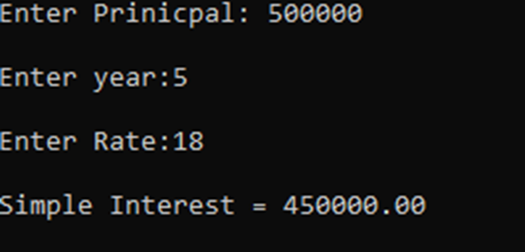
Example
printf("\nEnter year:");
scanf("%f",&b);
printf("\nEnter Rate:");
scanf("%f",&c); // taking all 3 values p,r and time
interest = Simple_int(a,b,c); // passing value in function
printf("\nSimple Interest = %.2f\n", interest); //output
printf("\n");
return 0;
}

Slide 18
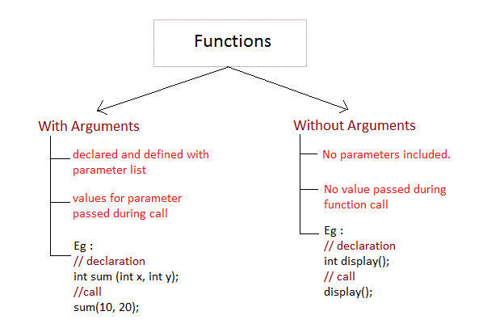
Passing Arguments to a function

Slide 19
Functions with Arguments
#include <stdio.h>
// Function that takes arguments and returns their sum
int sum(int a, int b)
{
return a + b;
}
int main()
{
int result;
// Calling the function with arguments 5 and 3
result = sum(5, 3);
printf("Sum: %d\n", result); // Output: Sum: 8
return 0;
}

Slide 20
Function Without passing Arguments
#include <stdio.h>
// Function that doesn't take any arguments and prints a message
void printMessage()
{
printf("Hello, World!\n");
}
int main()
{
// Calling the function without arguments
printMessage();
return 0;
}

Slide 21

Function Without passing Arguments
Example: Creating a void user defined function that doesn’t return anything
#include <stdio.h>
//function return type is void and it doesn't have parameters
void introduction()
{
printf("Hi\n");
printf("My name is Chaitanya\n");
printf("How are you?");
// There is no return statement inside this function, since its
return type is void
}
int main()
{
// calling function
introduction();
return 0;
}

Slide 22
HOW TO CALL C FUNCTIONS IN A PROGRAM?
There are two ways that a C function can be called from a program.
1. Call by value: A copy of the variable is passed to the function.
Example Syntex: swap(a, b);
2. Call by reference: An address of the variable is passed to the function.
Example Syntex: swap(&a, &b);

Slide 23
Call By Value
In call by value method, the value of the variable is passed to the function as parameter.
The value of the actual parameter can not be modified by formal parameter.
Different Memory is allocated for both actual and formal parameters. Because, value of actual parameter is copied to formal parameter.
Actual parameter – This is the argument which is used in function call.
Formal parameter – This is the argument which is used in function definition

Slide 24

Example - Swapping the values of the two variables
#include <stdio.h>
void swap (int a, int b)
{
int temp;
temp = a;
a=b;
b=temp;
// Formal parameters, a = 20, b = 10
}
int main()
{
int a = 10;
int b = 20;
printf("Before swapping:a = %d, b = %d\n",a,b);
swap(a,b);
printf(“In Final swapping: a = %d, b = %d\n",a,b);
}

Slide 25
Call By Reference
In call by reference method, the address of the variable is passed to the function as parameter.
The value of the actual parameter can be modified by formal parameter.
Same memory is used for both actual and formal parameters since only address is used by both parameters.

Slide 26
Example Swapping the values of the two variables
#include <stdio.h>
void swap (int *a, int *b)
{
int temp;
temp = *a;
*a=*b;
*b=temp;
printf("After swapping values in function a = %d, b = %d\n",*a,*b);
// Formal parameters, a = 20, b = 10
}
int main()
{
int a = 10;
int b = 20;
printf("Before swapping the values in main a = %d, b = %d\n",a,b);
// printing the value of a and b in main
swap(&a,&b);
printf("After swapping values in main a = %d, b = %d\n",a,b);
// The values of actual parameters do change in call by reference, a = 10, b = 20
}

Slide 27
Recursion
Recursion is the process which comes into existence when a function calls a copy of itself to work on a smaller problem.
Any function which calls itself is called recursive function, and such function calls are called recursive calls.
Recursion involves several numbers of recursive calls. However, it is important to impose a termination condition of recursion.
Recursion cannot be applied to all the problem, but it is more useful for the tasks that can be defined in terms of similar subtasks.
For Example, recursion may be applied to sorting, searching, and traversal problems.

Slide 28
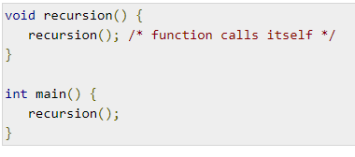
Recursion
Recursion is the process of repeating items in a self-similar way.
In programming languages, if a program allows you to call a function inside the same function, then it is called a recursive call of the function.

Slide 29
Example
Find the factorial of a given number
using recursion.
#include<stdio.h>
int fact(int n)
{
if (n>=1)
return n*fact(n-1);
else
return 1;
}
int main()
{
int n;
printf("Enter a positive integer: ");
scanf("%d",&n);
printf("Factorial of %d = %d", n,fact(n));
return 0;
}

Slide 30
Overview
Few Points to Note regarding functions in C:
main() in C program is also a function.
Each C program must have at least one function, which is main() function.
There is no limit on number of functions; C program can have any number of functions.
A function can call itself and it is known as Recursion.
C Functions Terminologies that you must remember the return type - Data type of returned value. It can be void also, in such case function doesn’t return any value.

Slide 31
Thank You!!!

